Slide 1
Building Applications with Angular CLI

Slide 2
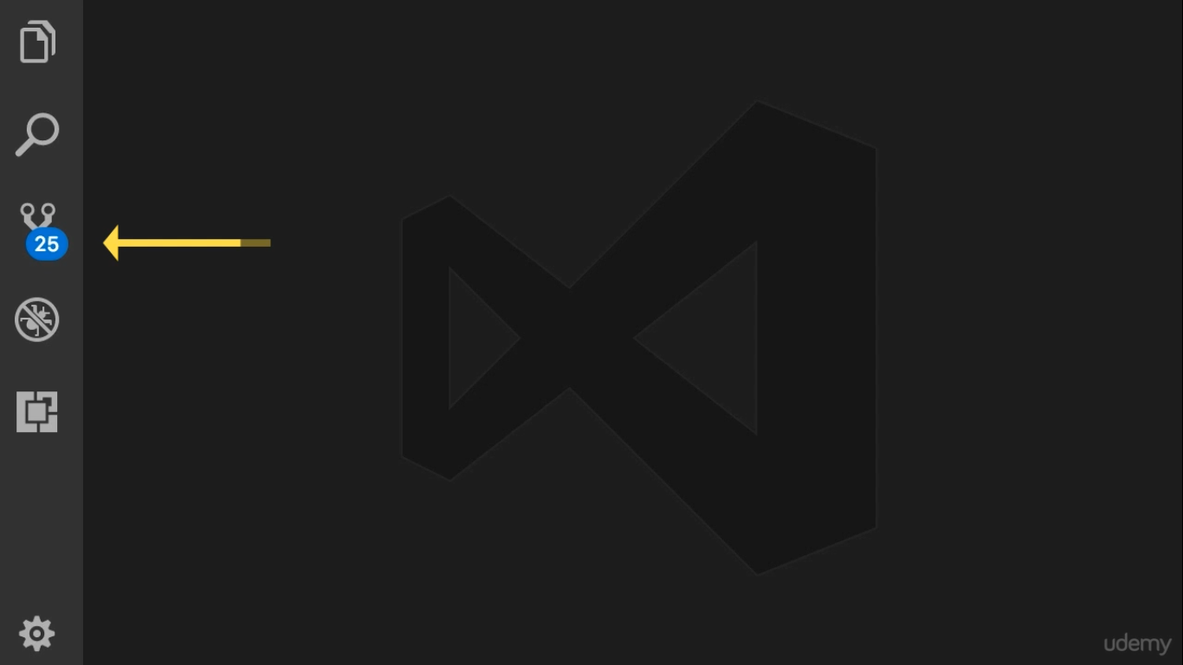

Slide 3
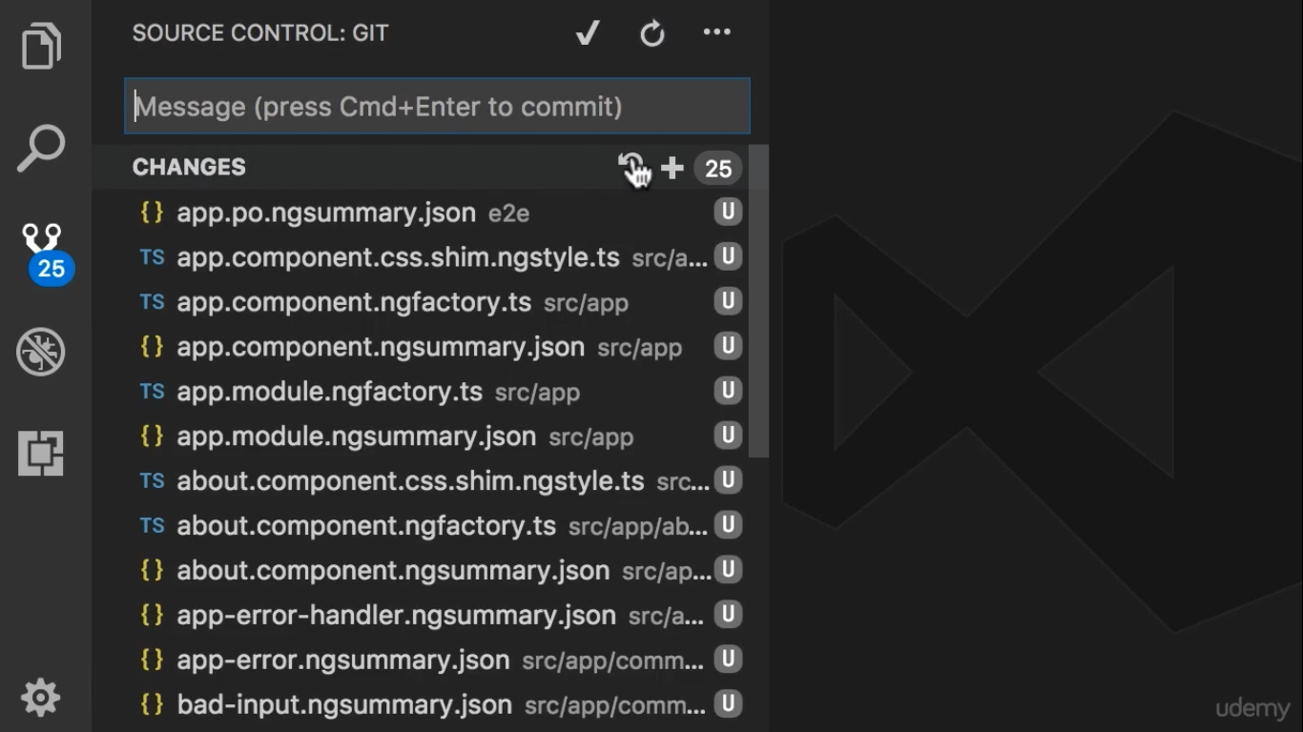

Slide 4
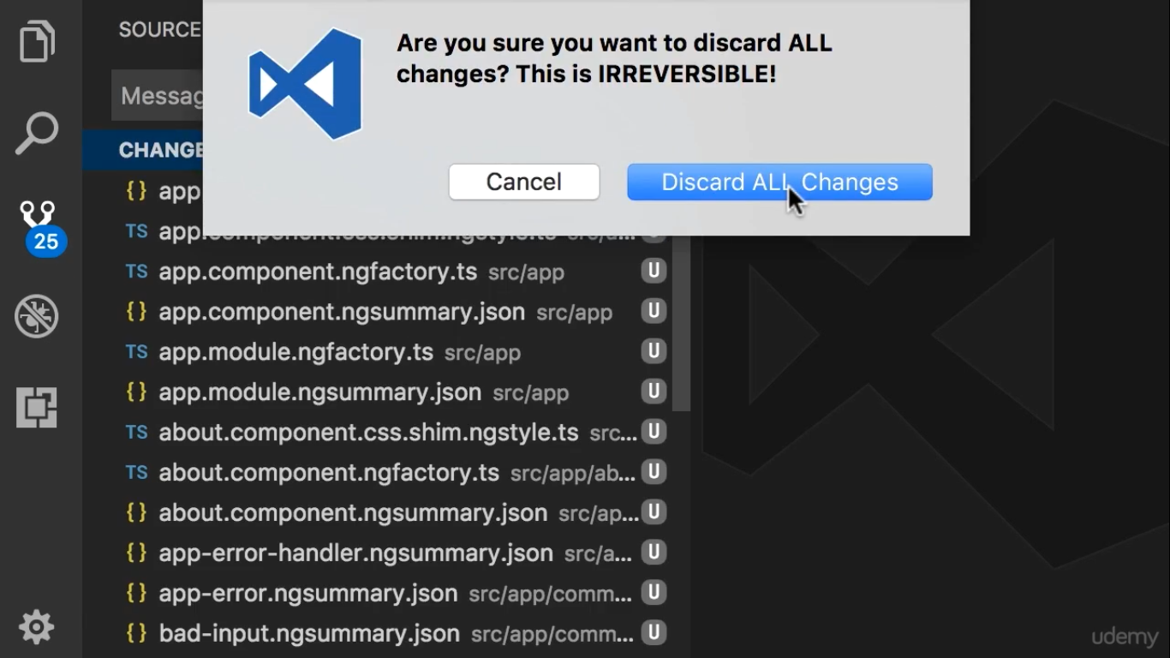

Slide 5
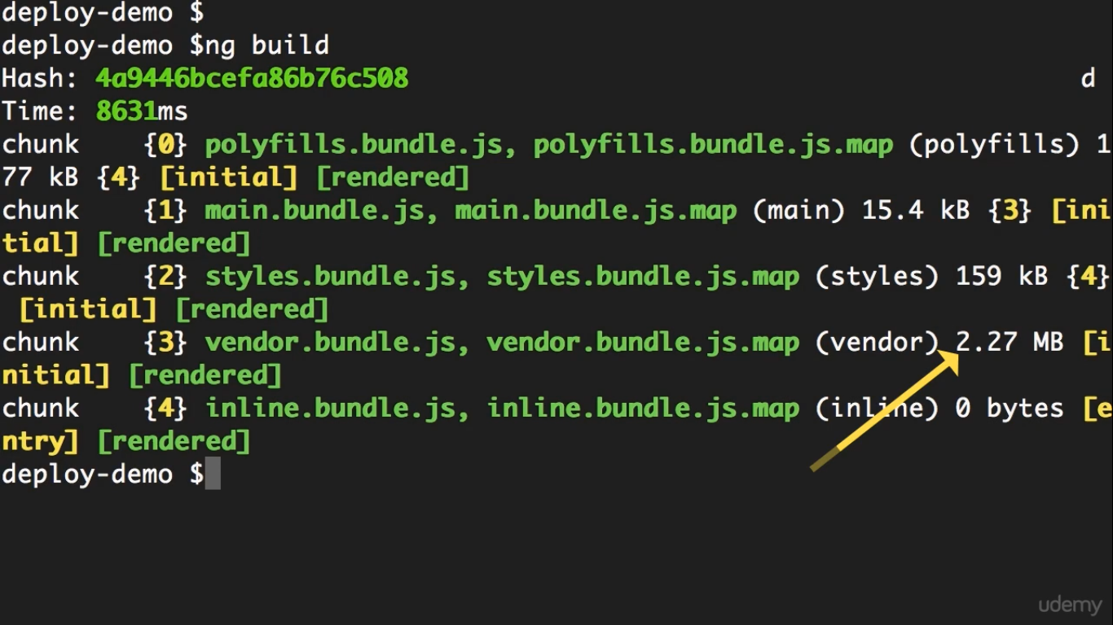

Slide 6
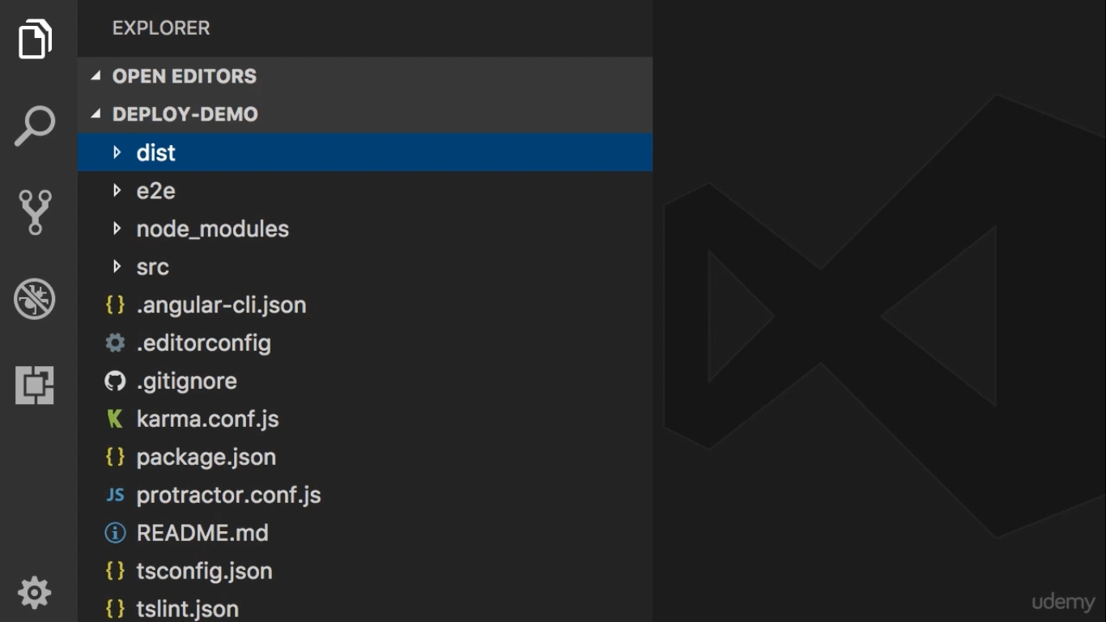

Slide 7
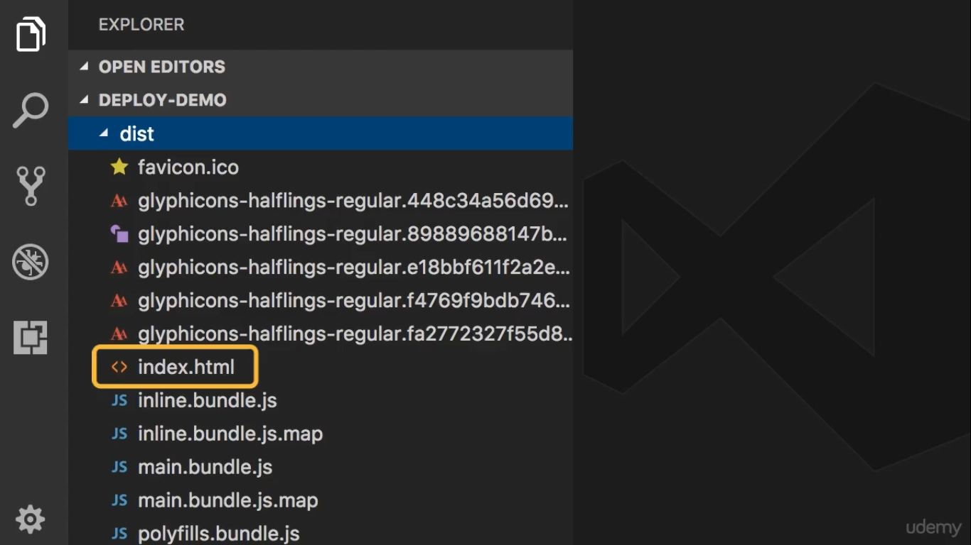

Slide 8
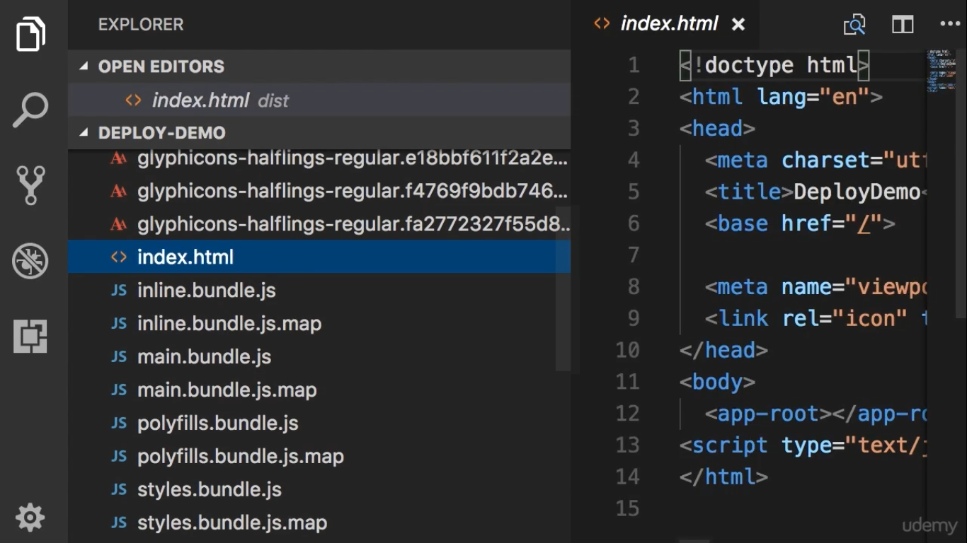

Slide 9
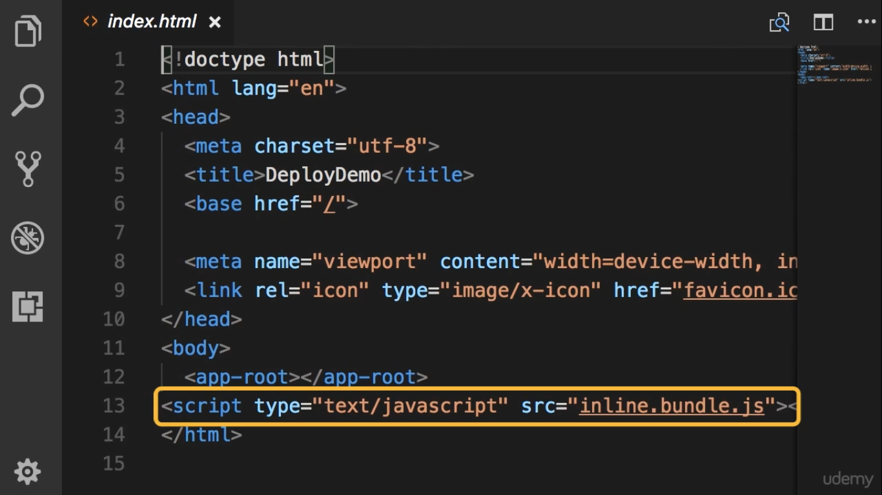

Slide 10
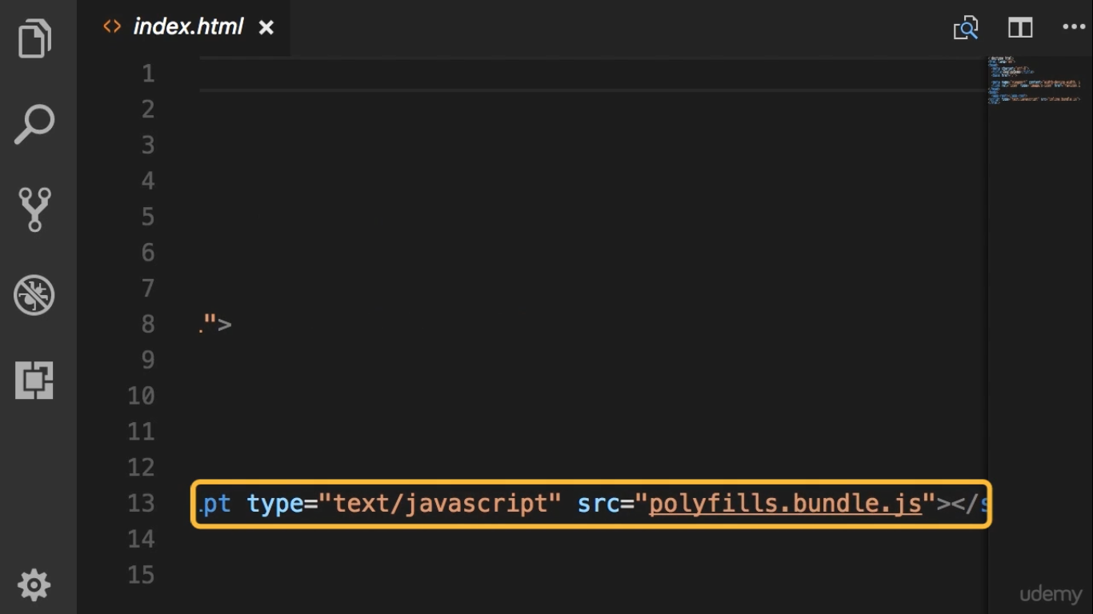

Slide 11
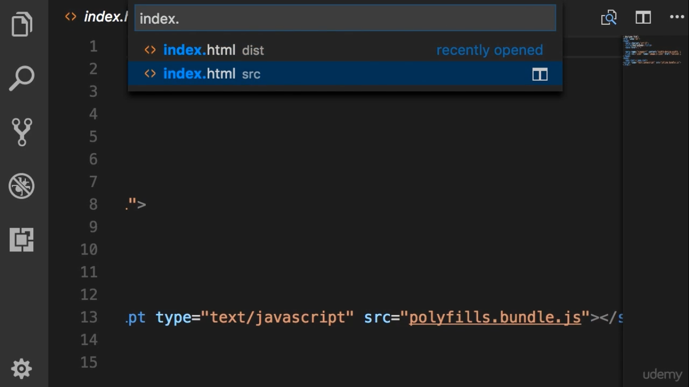

Slide 12
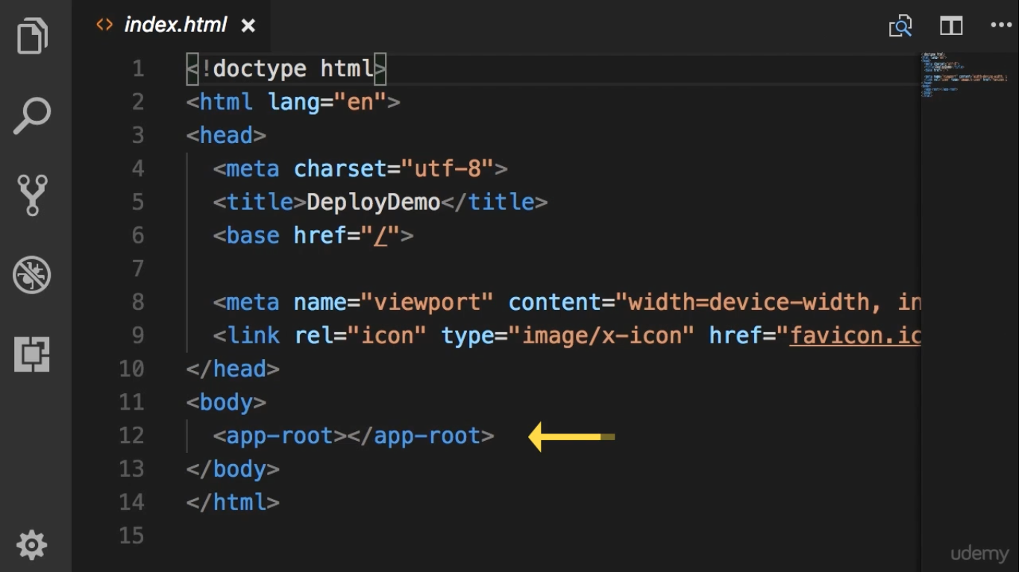
Don’t have any script references

Slide 13
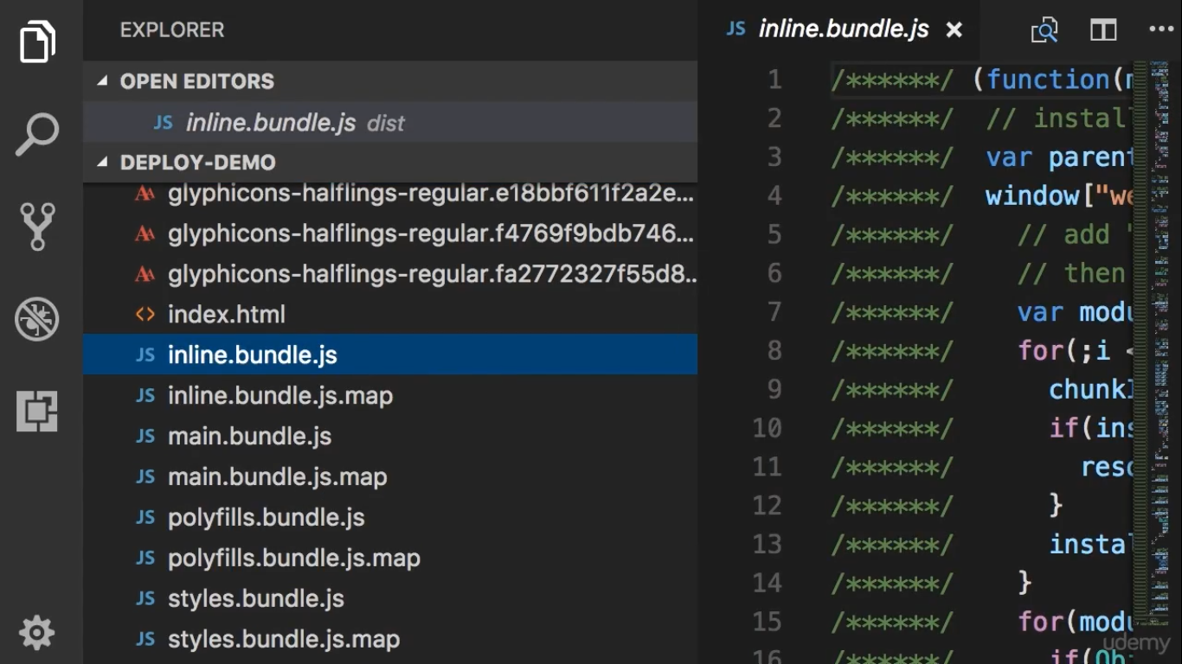

Slide 14
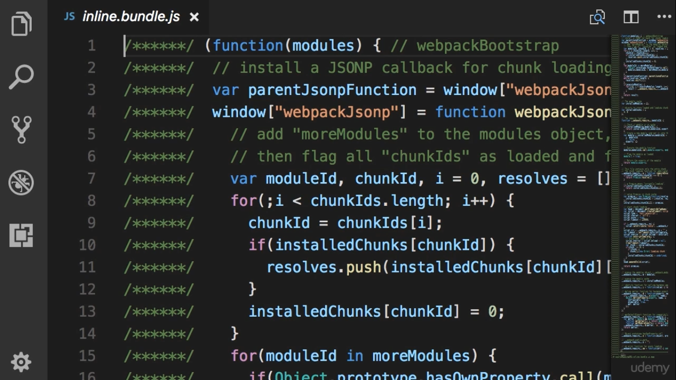
Don’t have any Optimization Techniques

Slide 15
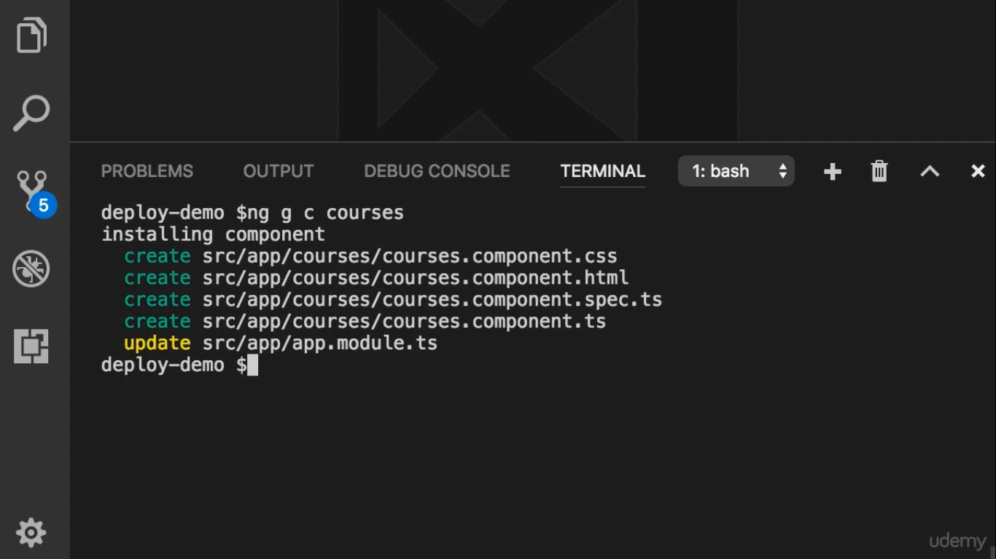
Don’t use this component anywhere in our component

Slide 16
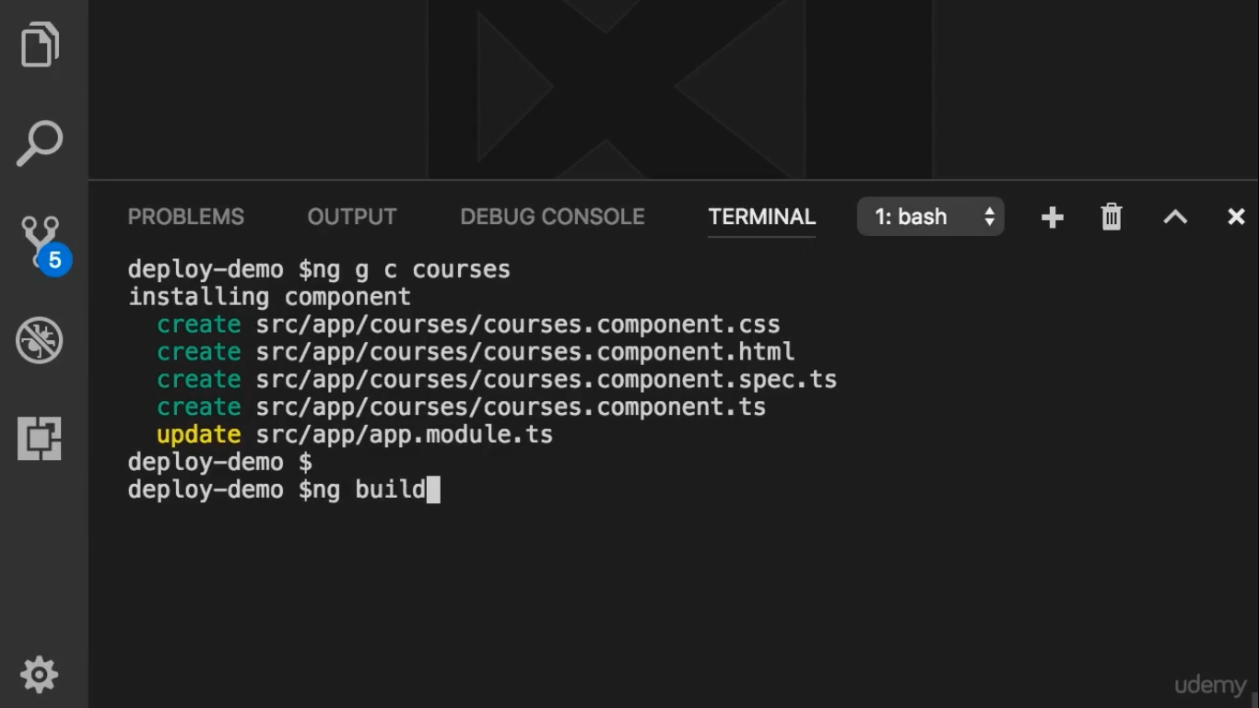
Build the application one more time

Slide 17
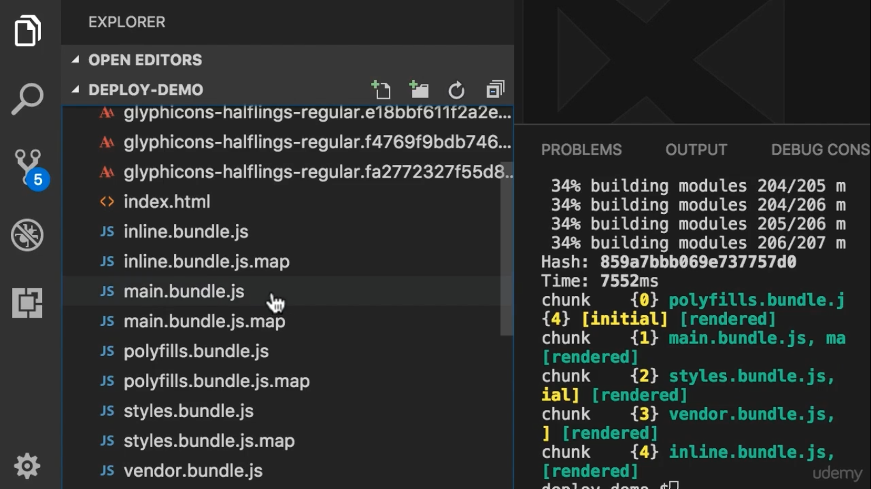

Slide 18
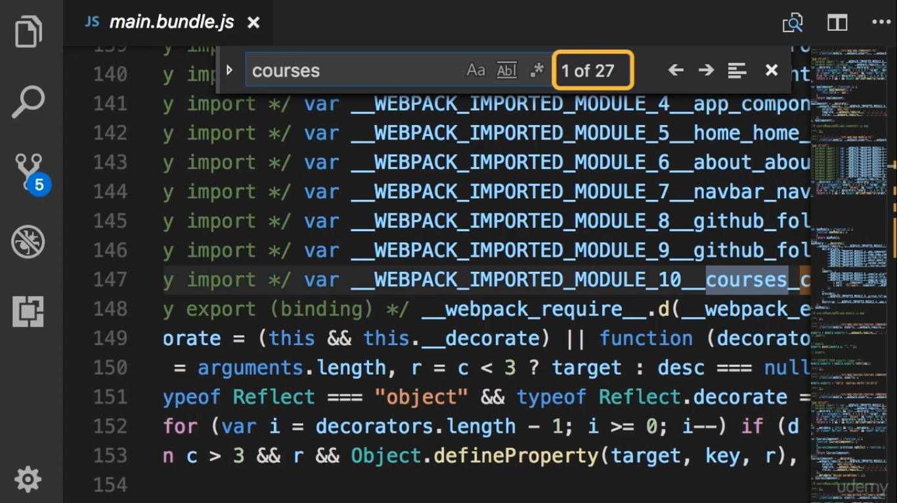

Slide 19
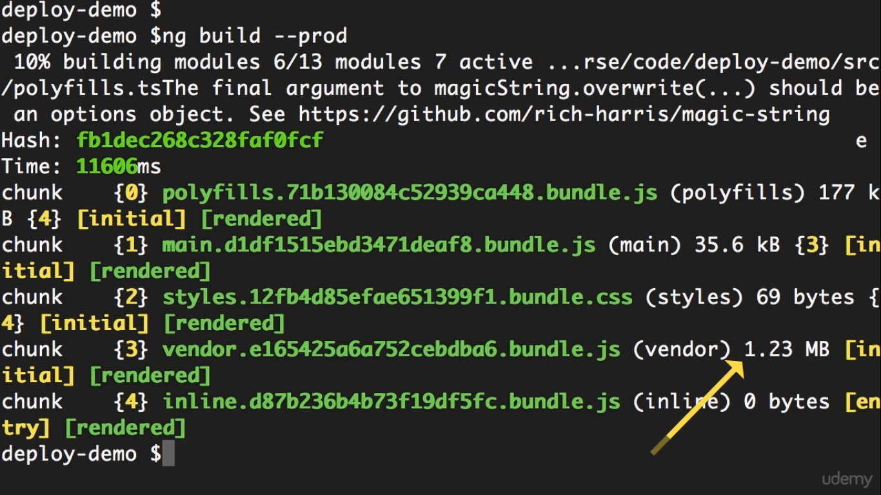
Minification နဲ႔ Ulglification ပါေသးတယ္
Angular Application က vendor bundle ထဲမွာမရွိေတာ့ဘူး

Slide 20
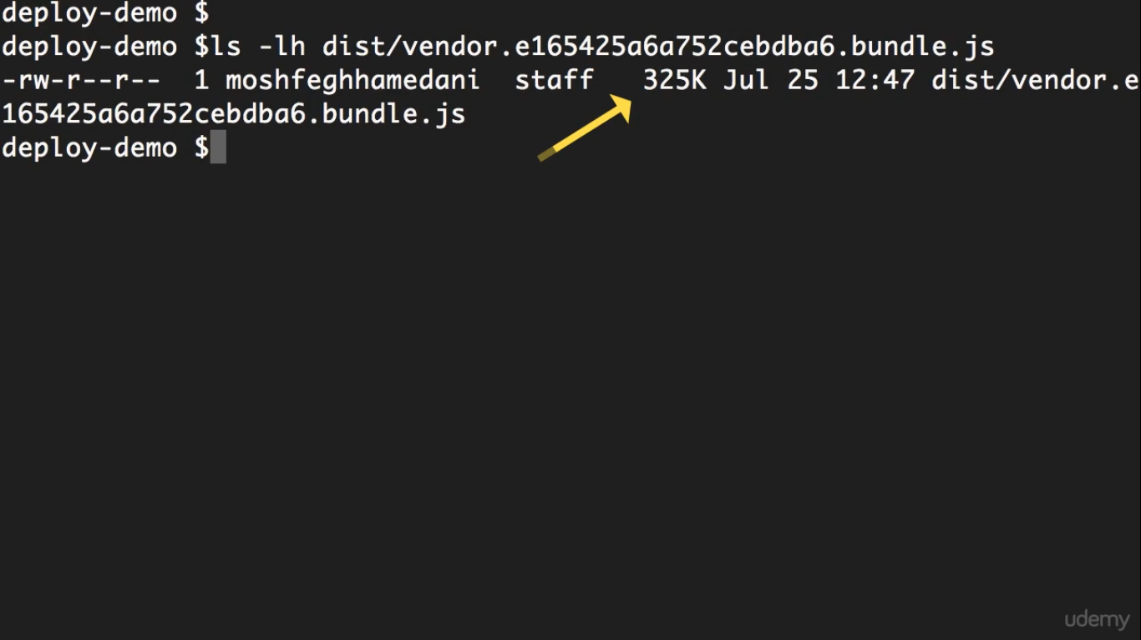
Minification နဲ႔ Ulglification မပါေတာ့ဘူး

Slide 21
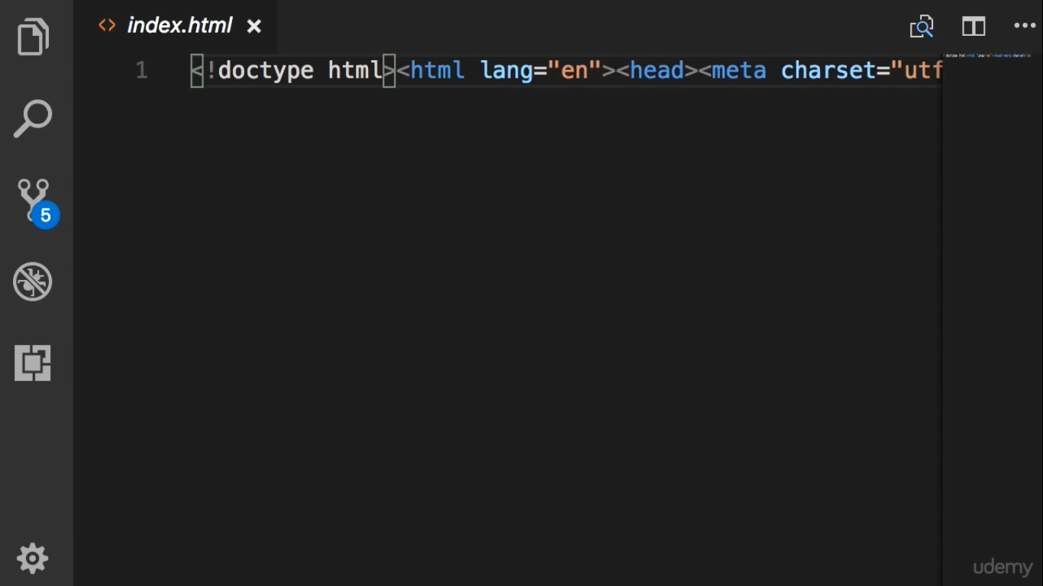
White space မ႐ွိေတာ့ဘူး

Slide 22
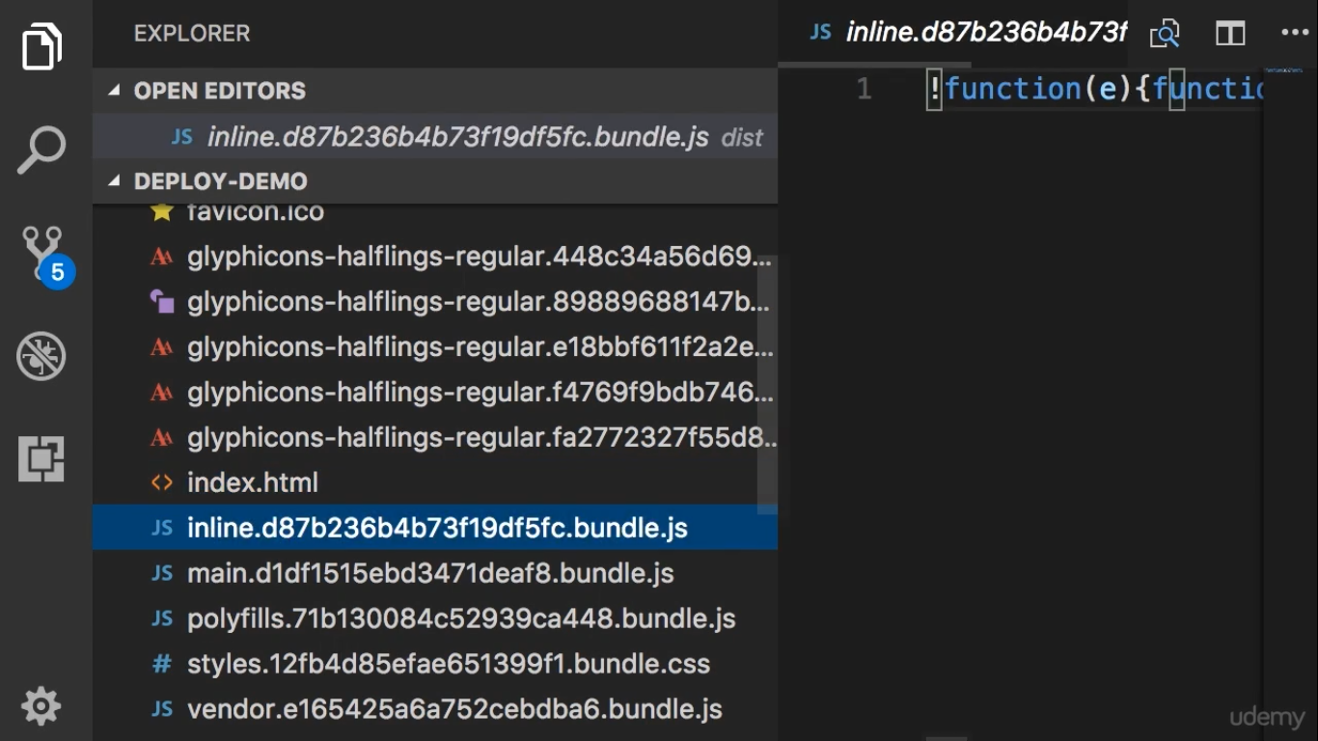

Slide 23
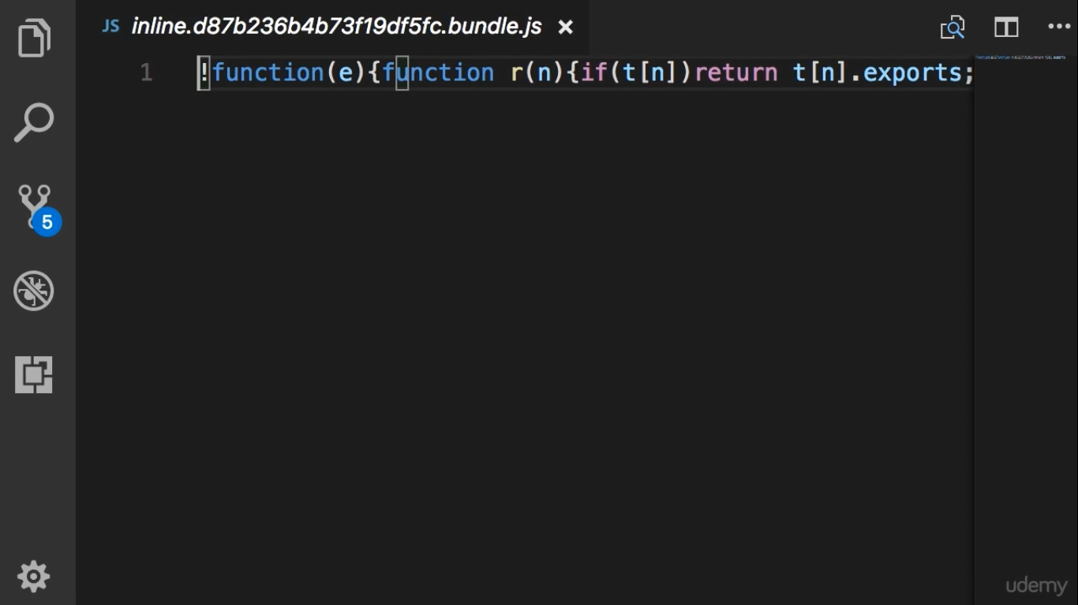
White space မ႐ွိေတာ့ဘူး

Slide 24
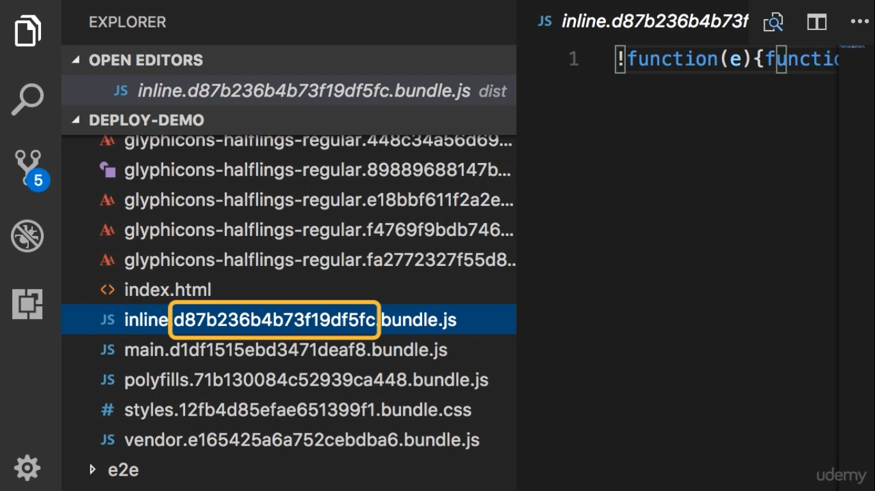
Random string = hash
This hash is generated
base on the content of the bundle
This prevent caching

